Slide 1

Capstone Project – Sprots Analysis
Srinath M

Slide 2
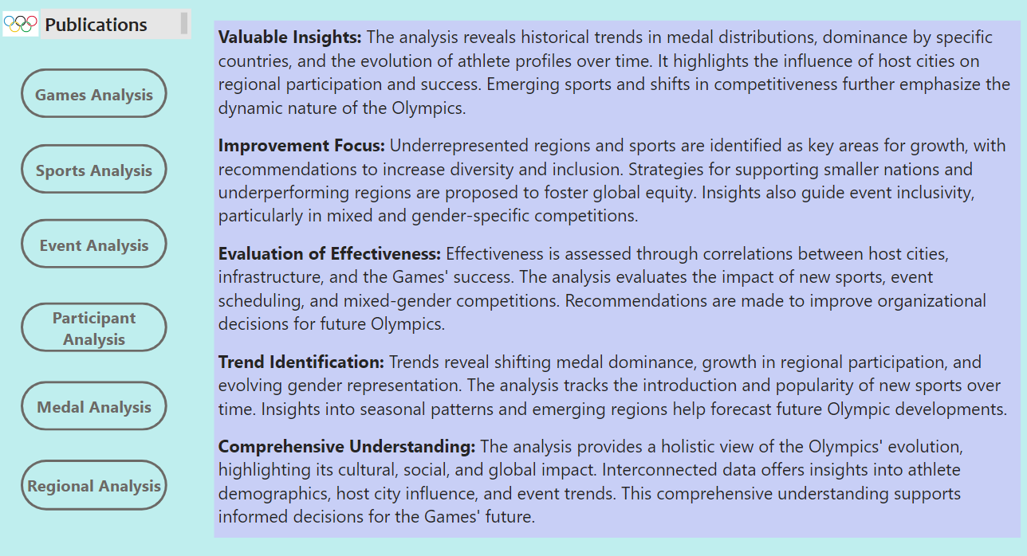

Slide 3



Objective; The objective is to explore the historical data of the Olympic Games across multiple dimensions, such as sports, events, participants, medals, and regional representation. This analysis aims to uncover trends, patterns, and insights that highlight the evolution and significance of the Olympics.
Analysis Scope: The analysis covers data from multiple editions of the Olympic Games, including both Summer and Winter events. It examines key areas such as athlete demographics, medal distributions, host city influence, and regional participation. Relationships between sports, events, and competitors are also analyzed to provide a comprehensive view.
Goal: The primary goal is to provide a detailed understanding of the Olympics' history, evolution, and global impact. Insights generated will inform strategies to improve future Olympic organization, sports selection, and representation of diverse regions.

Slide 4



Insights & Recommendations: Trends in medal dominance, growth in participation from emerging regions, and shifts in gender representation are identified. The analysis highlights the impact of host cities on regional success and emerging sports. Promote diversity by supporting underrepresented regions and sports. Increase inclusivity through equitable participation opportunities, focus on mixed-gender events, and encourage emerging sports to appeal to a wider audience.
Report & Presentation: The deliverable will include a comprehensive report detailing the findings, trends, and historical significance of the Olympic Games. A presentation will summarize key insights, recommendations, and their potential impact on future Olympic events, providing stakeholders with actionable strategies.
For the publishing, the Power BI dashboard, report, and presentation are all effective tools. will enable them to make wise choices, maximize book sales tactics, and encourage author cooperation in the cutthroat publishing industry.

Slide 5

ER Diagram

Slide 6


Pawar BI problem statement

Slide 7
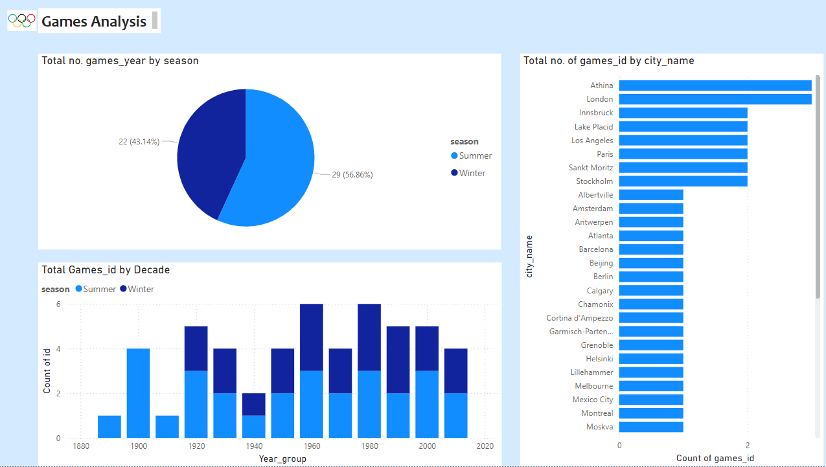

Slide 8
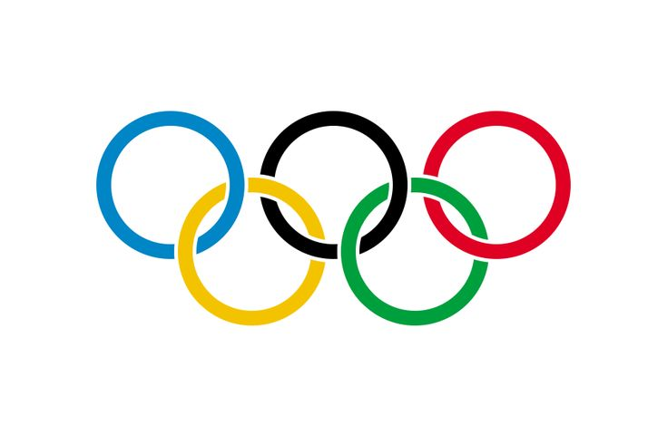

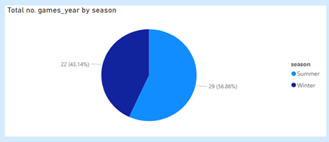
1. How many Olympic Games have been held in each season (Summer vs. Winter)?
The analysis shows that Summer Olympics are more frequent and widely attended, while Winter Olympics have steadily expanded. Hosting patterns, scheduling changes, and the separation of both editions highlight the Games' growth and geographical reach. These insights help guide future decisions on scheduling, host city selection, and overall Olympic organization.

Slide 9
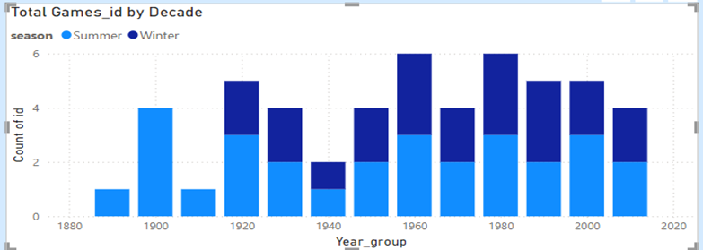
2. What is the distribution of games across different decades?
The analysis highlights the Olympic Games' growth, with increasing participation, new sports, and expanded events over decades. Hosting spread across continents, making the Games more globally inclusive. Recent editions have grown in scale, attracting larger audiences and sponsorships. These trends help in planning future Olympics for continued expansion and impact.

Slide 10
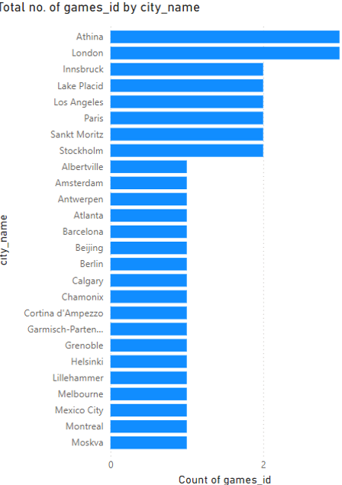
3. Which cities have hosted the most Olympic Games?
The analysis of the Games City table reveals the most frequent Olympic host cities, including London, Paris, and Los Angeles, each hosting three times. These insights highlight the global spread of the Olympics and the significance of key host cities in its history.

Slide 11
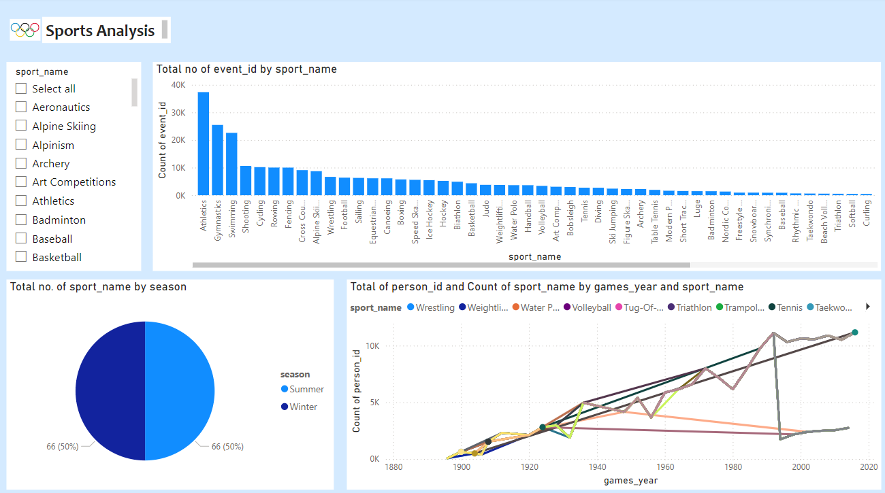

Slide 12
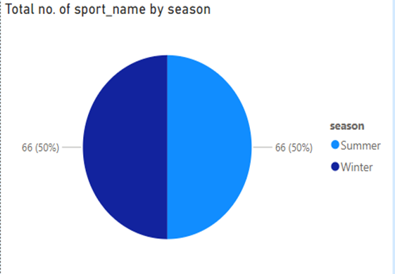
4. What is the distribution of sports between Summer and Winter Olympics?
The analysis shows that the Summer Olympics feature more sports than the Winter Olympics, as seen in the Games and Sport tables. Summer events include Athletics, Swimming, and Gymnastics, while Winter Games focus on sports like Alpine Skiing and Ice Hockey. Some sports are exclusive to each season, such as Cycling for Summer and Bobsleigh for Winter. Over time, new sports have been introduced, expanding the diversity of both Olympic editions.

Slide 13
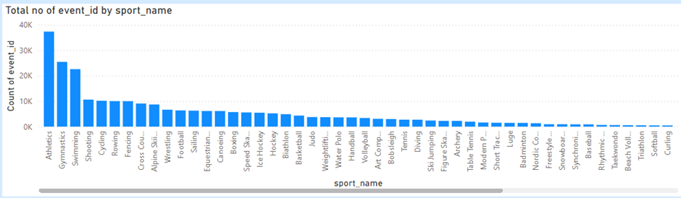
5. Which sports have the highest number of events in the Olympics?
The analysis shows that Athletics has the highest number of events, followed by Swimming and Gymnastics. Sports like Cycling, Weightlifting, and Wrestling also have many events due to multiple categories and weight classes. Shooting and Fencing historically featured numerous events due to their diverse formats. Overall, sports with various disciplines and classifications tend to have the most events.

Slide 14
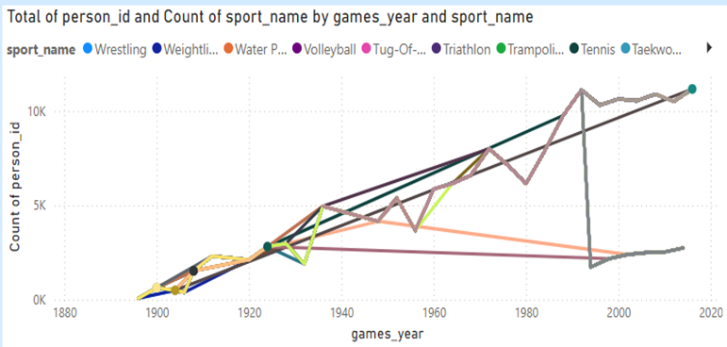
6. How has the participation in each sport evolved over time?
The analysis shows that Athletics and Swimming have consistently high participation due to their numerous events and accessibility. Gymnastics and Cycling have grown steadily, while team sports like Basketball, Volleyball, and Football have expanded over time. Participation trends are influenced by new events, rule changes, and increased athlete representation. Overall, the Olympics have seen continuous growth in sports participation, reflecting greater global involvement.

Slide 15
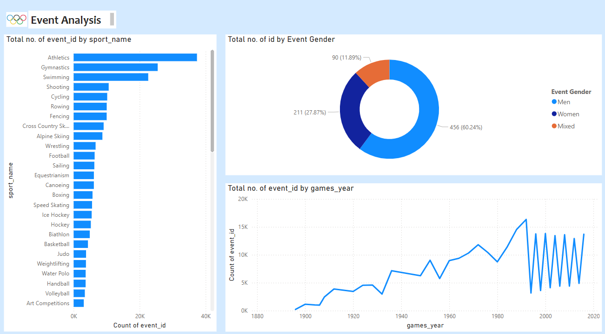

Slide 16
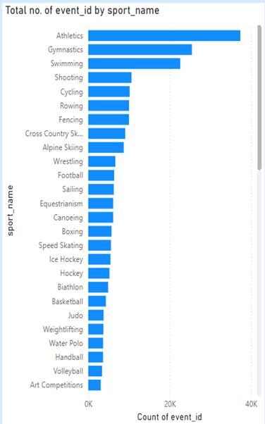
7. How many events are there in each sport?
The analysis shows that Athletics gymnastics and Swimming have consistently high participation due to their numerous events and accessibility. Cycling have grown steadily shooting, Football have expanded over time. Participation trends are influenced by new events, rule changes, and increased athlete representation. Overall, the Olympics have seen continuous growth in sports participation, reflecting greater global involvement.

Slide 17
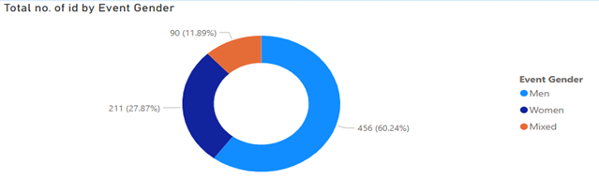
8. What is the distribution of events by gender (Men, Women, Mixed)?
Historically, Men's events dominated, but recent Olympic editions have significantly increased Women's and Mixed events. Many sports now feature near parity, with added women's categories and mixed formats promoting gender inclusivity.

Slide 18
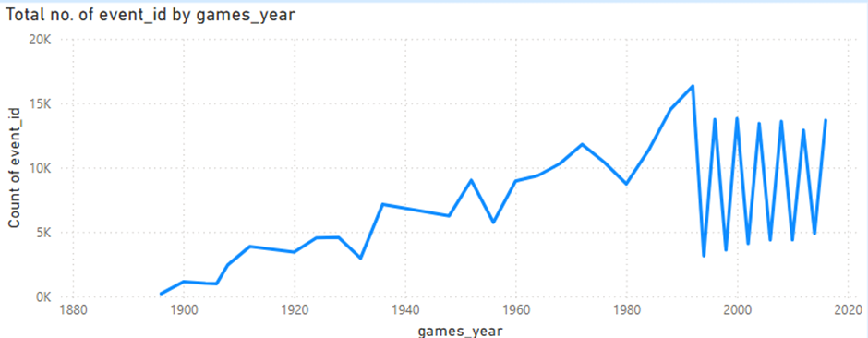
9. How has the number of events changed over time?
The analysis shows that early Olympic editions featured fewer events, primarily focusing on Athletics, Gymnastics, and Swimming. Over time, new sports such as Basketball, Judo, and Taekwondo were introduced, contributing to a steady increase in events. The growth was further boosted by the addition of women's and mixed competitions and the expansion of disciplines like Cycling and Weightlifting. Overall, the Olympic Games have continuously evolved, reflecting greater diversity in sports and athlete participation.

Slide 19
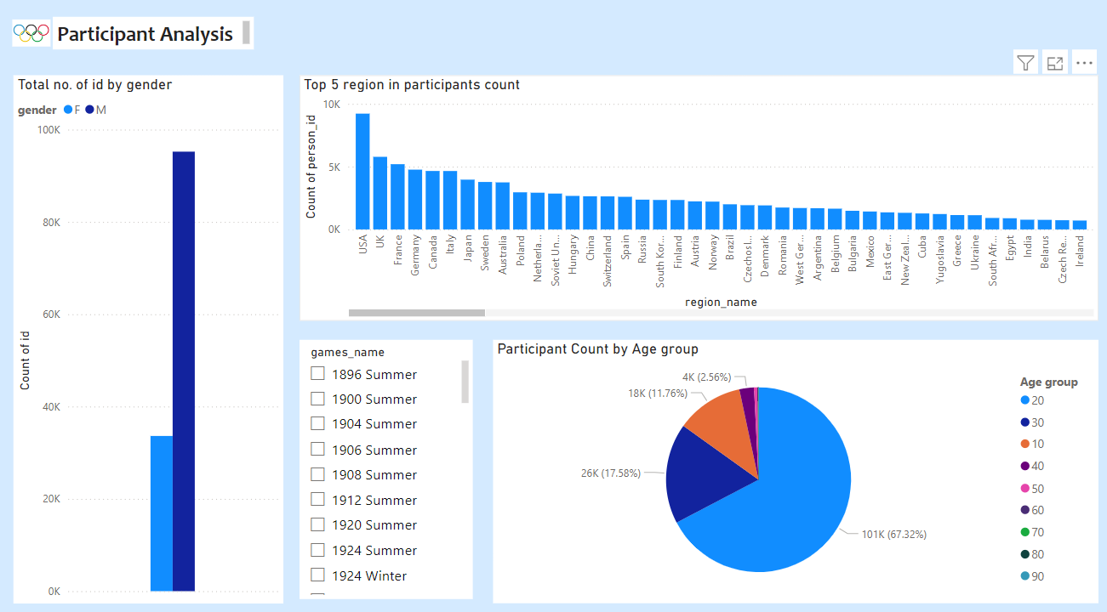

Slide 20
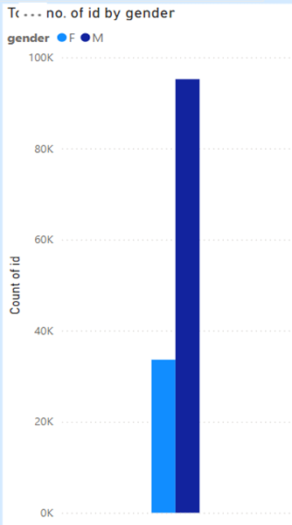
10. What is the distribution of participants by gender?
Early Olympic editions had mostly male competitors, but female participation has steadily increased. The dataset captures gender trends across different Games, showing variations by sport and event. Mixed-gender events and policy changes have contributed to a more inclusive competition landscape. Overall, the Olympics continue progressing toward greater gender balance in global sports.

Slide 21
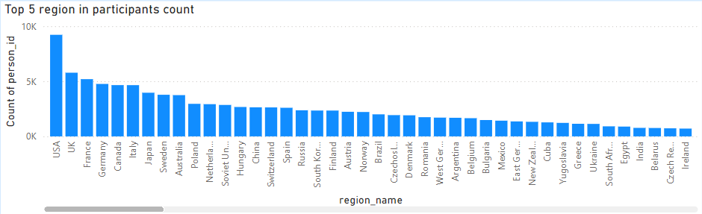
11. Which countries have the highest number of participants in the Olympics?
Countries with large populations and strong sports programs have the highest Olympic participation. Host nations often experience a surge in athletes due to automatic qualifications and increased investment. Countries like USA, France, and the UK have historically had strong representation, especially in team sports. Overall, participation has grown over time, reflecting expanded events and broader global inclusion.

Slide 22
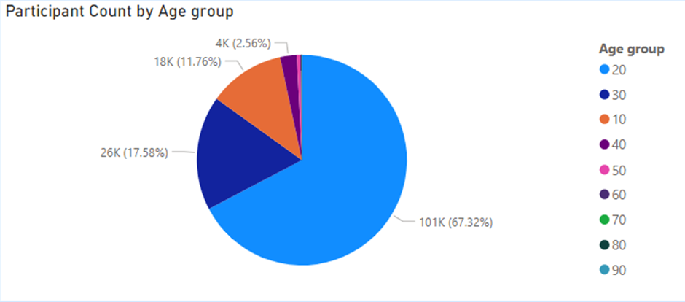
12. How does the age distribution of participants vary across different games?
The dataset reveals trends in the age distribution of Olympic athletes across different Games editions. Younger athletes dominate agility-based sports like gymnastics, while older competitors excel in endurance events such as marathons. Advances in training and sports science have extended athletes' careers, contributing to a gradual increase in average age. The inclusion of new sports and age-group categories has further shaped participation patterns over time.

Slide 23
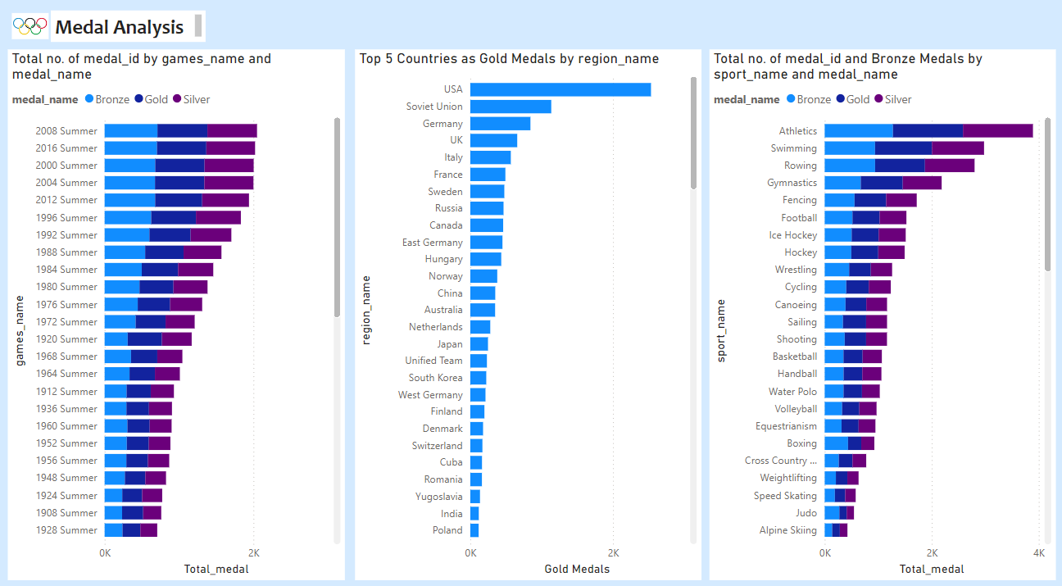

Slide 24
13. How many medals have been awarded in each Olympics?
The dataset tracks Olympic medal distribution across different editions, linking each medal to the competitor and event. Medal counts have increased over time due to the expansion of sports, events, and participating athletes. Team events contribute multiple medals, and host nations introducing new sports can temporarily boost totals. Overall, the trend reflects the Olympics' growth, with a steady rise in awarded medals.

Slide 25
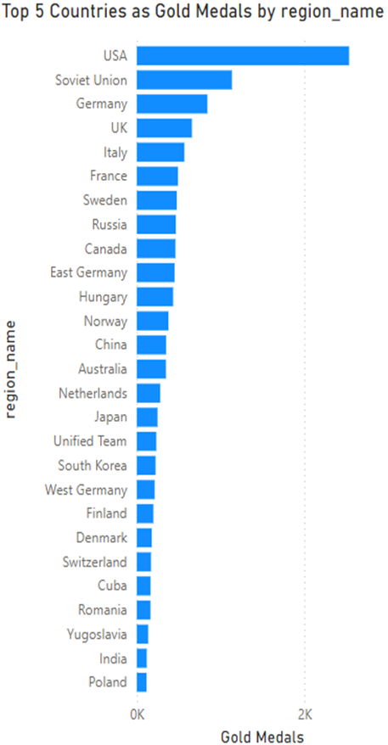
14. Which countries have the highest number of gold medals?
The dataset tracks gold medal achievements, linking winners to their countries and enabling analysis of national success. Nations with strong sports programs, like the U.S., Russia, and Germany , consistently lead in gold medal counts. Host countries often gain an advantage, and team events further boost totals for dominant nations. Over time, gold medal distribution has increased with new sports, highlighting both long-term dominance and emerging competitors.

Slide 26
15. How does the medal distribution vary across different sports?
The dataset analyzes medal distribution across sports, showing that athletics and swimming award the most medals due to numerous events. Team sports like football and basketball contribute fewer medals but impact national rankings. Individual sports offer more medal opportunities, while newer Olympic sports influence overall trends. As the Games expand, the diversity of medal-winning sports continues to grow.

Slide 27
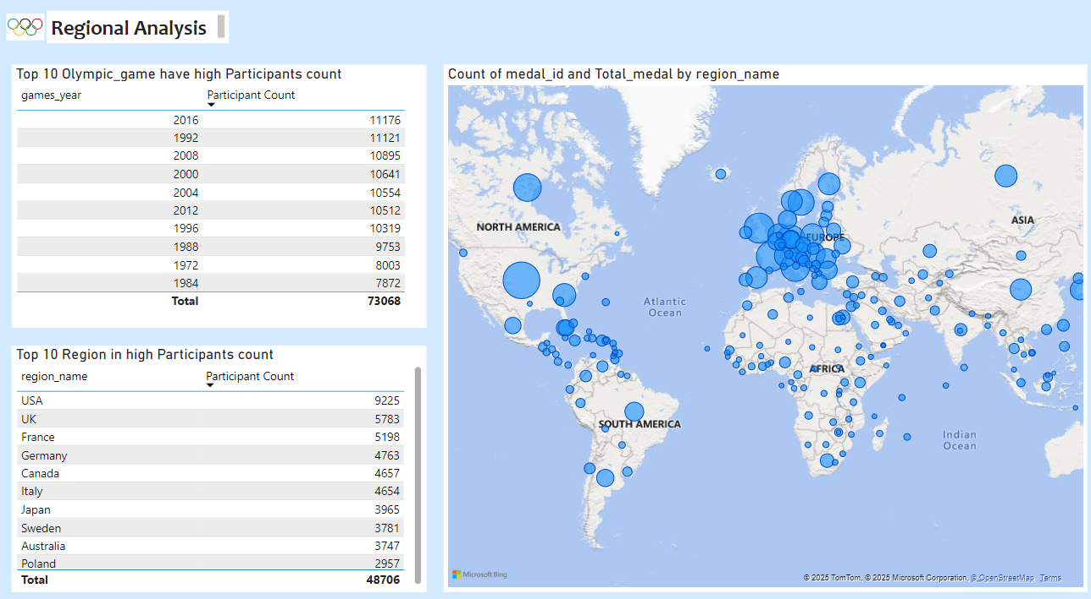

Slide 28
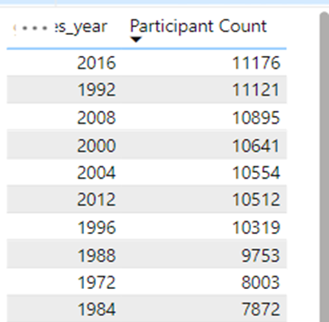
16. How many regions or NOCs participate in each Olympic Games?
The dataset tracks National Olympic Committees (NOCs) and regional participation, showing steady growth over time. Early Games had fewer NOCs, but participation expanded as new nations gained recognition. Universally popular sports like athletics and swimming attract nearly all NOCs, contributing to diversity. Overall, the Olympics continue to unite an increasing number of nations through sports.

Slide 29
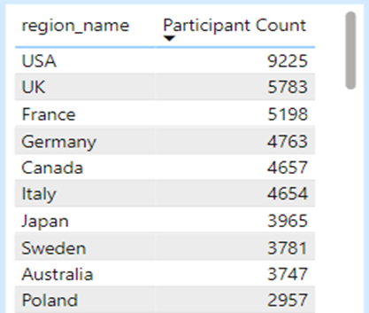
17. Which regions have the highest number of participants in the Olympics?
The dataset tracks Olympic participation by region, showing that nations with strong sports programs, like the U.S., China, and Russia, consistently have high athlete counts. Host nations often see increased participation due to automatic qualifications and athlete support. Team sports further boost numbers, and new events have expanded overall athlete representation. The trend highlights growing global diversity and the Olympics' expanding reach.

Slide 30
18. What is the distribution of medals among different regions?
The dataset tracks regional medal distribution, showing that nations with strong sports programs, like the U.S., Germany, and the U.K., consistently secure high medal counts. Some regions specialize in specific sports, while host nations often see temporary medal increases due to home advantage. Team and combat sports significantly impact medal distribution, with multiple athletes receiving awards. Over time, Olympic expansion has led to more regions achieving medal success, increasing global competition.

Slide 31
EDA problem statement

Slide 32
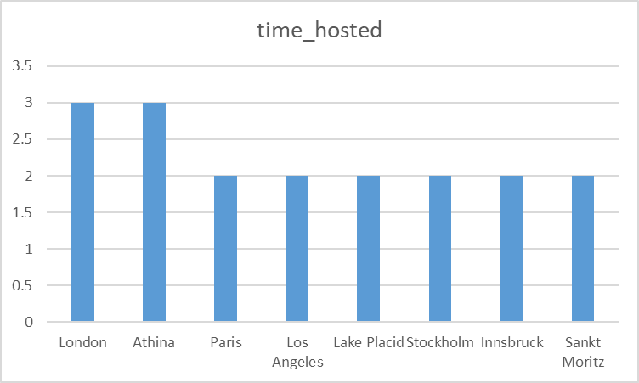
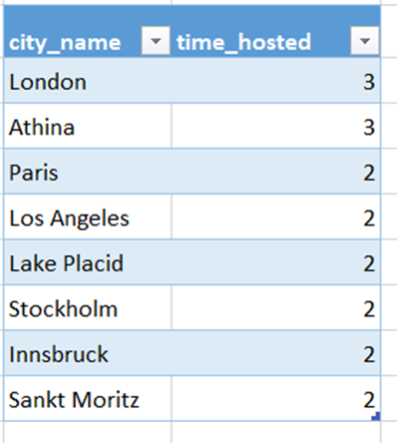
Are there any trends or patterns in the frequency of hosting Olympic Games?
Conclusion: Locating Cities With Multiple Olympic Hosting Cities that held the Olympics more than once are found with this query. The two cities that have hosted the most Olympic Games London and Athina have done it three times. Two Olympic Games have been held in Paris, Los Angeles, Lake Placid, Stockholm, Innsbruck, and Sankt Moritz.

Slide 33
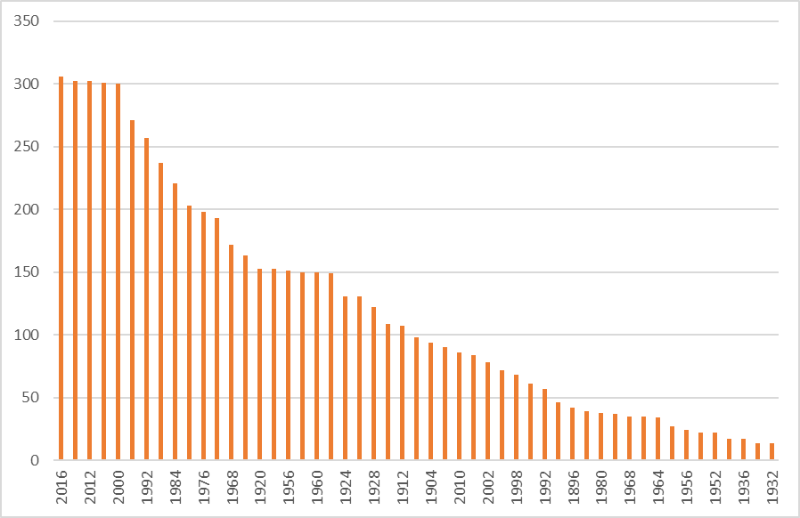
2. How has the duration of Olympic Games changed over time?
Conclusion: The majority of the Olympic Games were held in the winter in the past, however today the For a considerable amount of time, the way the Olympic Games are held has evolved. As of the 20s, the majority of the games are held in the summer as well as winter and the number of events at the Olympics keeps growing. It has been demonstrated that the 20,s Olympics featured more orderly events.

Slide 34
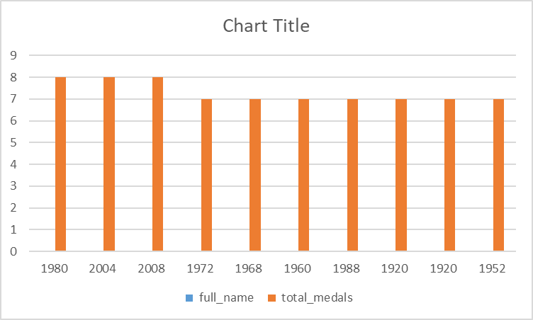
3. Are there any notable events or occurrences associated with specific Olympic Games?
Conclusion: The top 10 athletes who have won the most Olympic medals in the particular Olympic game are displayed in this query, thus first we may Aleksandr Nikolayevich Dityatin and Michael Fred Phelps II are the most medal winners with eight medals overall from a particular Olympic Games. Next up are those who have won seven medals overall in particular Olympic gains. Mark Borys Anfiyanovych Shakhlin, Andrew Spitz, Mikhail Yakovlevich Voronin, and Matthew Nicholas The chart lists Matt Biondi, Willis Augustus Lee Jr., Lloyd Spencer Spooner, Mariya Kindrativna Horokhovska, and the game of the year they won.

Slide 35
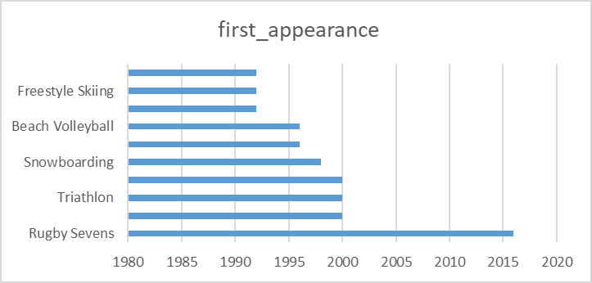
4. Are there any emerging sports that have been recently added to the Olympics?
Conclusion: The top 10 recently added sports editions are returned in this query. As you can see, the games that were added by the most recent year are rugby sevens, trampolining, triathlon, Taekwondo, snowboarding, softball, beach volleyball, short track speed skating, freestyle skiing, and badminton. In order to identify the oldest Olympic edition (MIN(g.games_year)) in which each sport was introduced, this query will emphasize sports that were launched in the most recent Olympic editions.

Slide 36
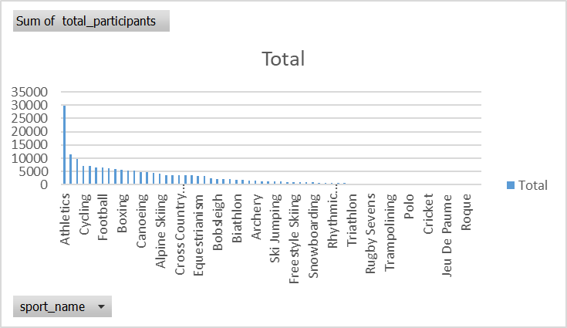
5. How has the popularity of certain sports changed over the years?
Conclusion: The number of participants in each sport, categorized by Olympic game year, will be returned by this query. Athletics, gymnastics, rowing, shooting, tennis, cycling, fencing, swimming, and weightlifting have the highest participation rates. The sport year is added to the slicer to filter the appropriate year for each sport event in the Olympic year, allowing us to find the returns with the highest number of participants. The top three sports with the highest participation counts are athletics, gymnastics, and Rowing.

Slide 37
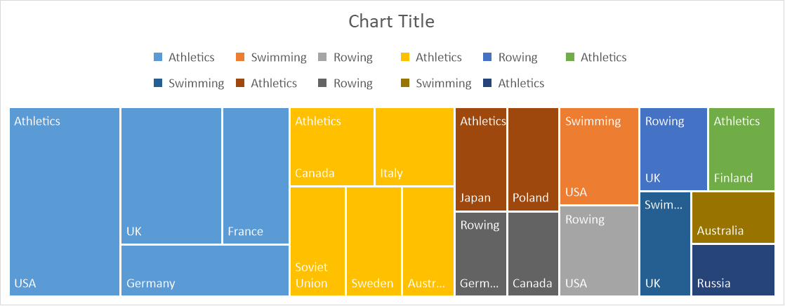
6. Are there any sports that are specific to a particular region or culture?
Conclusion: Athletics, swimming, and rowing have the highest participation rates among the three sports. shows that the USA is the top competitor in this particular sport and holds the second-most-dominant position in terms of participants followed by the UK.

Slide 38
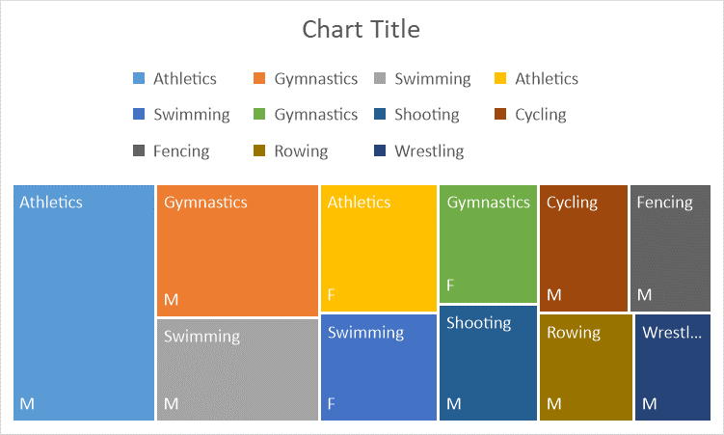
7. Are there any sports that have a higher number of events for one gender compared to others?
Conclusion: These are the top five sports with a higher number of male participants than females are athletic, gymnastic, swimming, cycling, and fencing. The tree map clearly displays the distribution of male and female athletes' participation rates.

Slide 39
8. Are there any new events that have been introduced in recent editions of the Olympics?
Conclusion: In this query we will return the new event that has been introduced in the recent edition of this Olympic which is gymnastics men's individual all around that is the new event edition add in the Olympics

Slide 40
9. Are there any events that have been discontinued or removed from the Olympics?
Conclusion: This query we will return the event that has been discontinued or removed from the Olympic Games these are the list of events that has been discontinued in the Olympic Games In the recent edition of Olympics Which is the comparison between the recent Olympic events and the previous ones

Slide 41
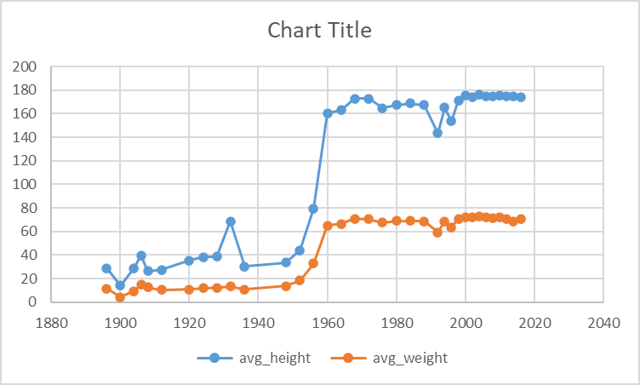
10. Are there any notable trends in the height and weight of participants over time?
Conclusion: This will show the notable trend in the participant's weight and height over time. When comparing the height of the athlete from the previous Olympic Games to the most current ones, there have been noticeable increases in the average height. It has been demonstrated that the average height of the participants has changed noticeably throughout the extended period of time. There is a modest increase in the average weight in the mid-1960s, but there is a large increase in the average weight in the mid-1960s. In contrast, the average weight has been steady in the recent games from 1960 to 2016.

Slide 42
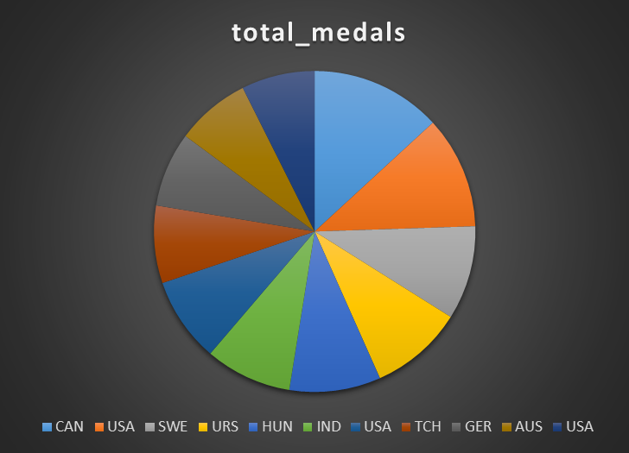
11. Are there any dominant countries or regions in specific sports or events?
Conclusion: Sweden dominates the ice hockey world in terms of medals won. India dominates the highest medal winnings in hockey, whereas the United States dominates the best medal winnings in arts competitions. Hungary leads the world in water polo medals, while the United Kingdom leads the world in rowing medals.

Slide 43
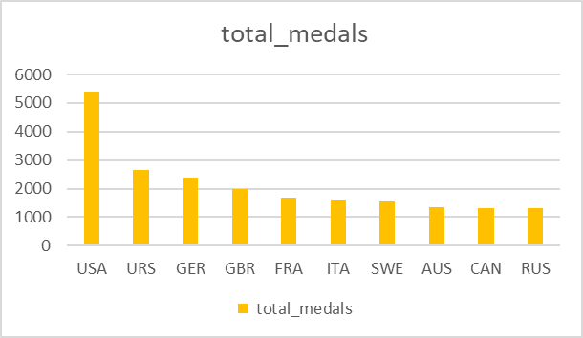
12. What factors contribute to the success or performance of participants from different countries?
Conclusion: USA, UK and France are the top 3 countries which won the most number of medals in the Olympic Games in over the time. The average Hight weight and age which supports the participants to score more number of medals and increased in participant count for these three countries is also one significant which helps to win more medals when compare to the all-other countries

Slide 44
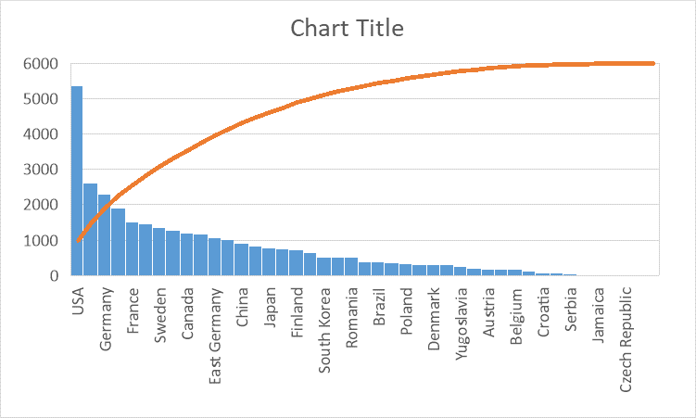
13. Are there any countries that consistently perform well in multiple Olympic editions?
Conclusion: Russia, USA and UK are some countries that shown the good performed over the year number of medals in the Olympic Games in over the time and increased in participant count for these three countries is also one significant which helps to win more medals when compare to the all-other countries

Slide 45
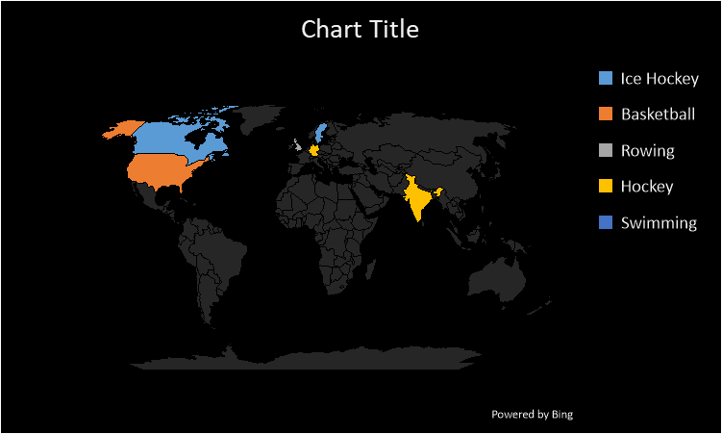
14. Are there any sports or events that have a higher number of medalists from a specific region?
Conclusion: This query returns the high number of medalist for specific region which shows that the we take participant count as the medalist USA is dominant in Ice Hockey and India is dominant in hockey and football is dominant in Italy and rowing is dominant in UK, Which here that concludes that the participant count this taken for each region to count the medalist when it comes to higher number of medals count the participants may be repeated in some regions.

Slide 46
15. What are some notable instances of unexpected or surprising medal wins?
Conclusion: This query gives us the comparison between the average medals winning by the countries for the specific sports. This gives us the USA and Sweden and UK RE the top 3 countries gives a consistency higher medal count compare to the Average medal count for the specific sport and countries , This Also gives us for the specific Olympic games year

Slide 47
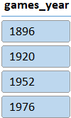
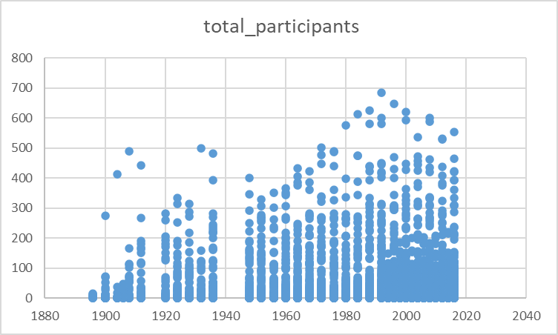
16. Are there any regions that have experienced significant growth or decline in Olympic participation?
Conclusion: New found, land north broneo, South Sudan and South yamen these are the regions have very least number of participant count and USA, UK, France, Germany and Italy have the more participant count in Olympic Games which has shown that the Olympic game participant count is continuously increasing over the period of time.

Slide 48

17. How do cultural or geographical factors influence the performance of regions in specific sports?
Conclusion: When it comes to summer season Olympic Sports USA UK France are the top 3 medal winning regions and when it comes to winter season Olympic sports USA Canada Italy are the countries holding the top 3 medal winning regions. This shows that USA place the predominant role in winning medal in both winter and summer season.

Slide 49
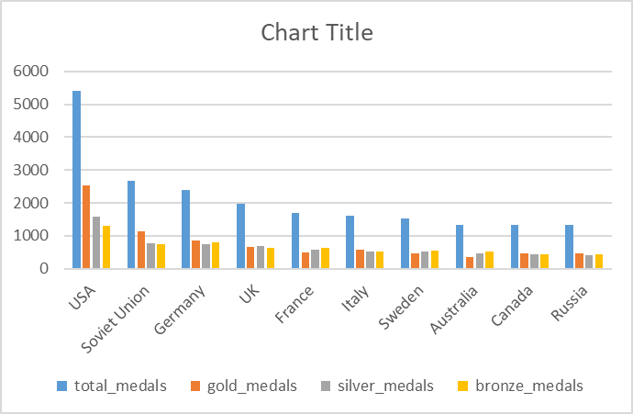
18. Are there any regions that have had a notable impact on the overall medal tally?
Conclusion: USA, UK and France are the top 3 countries which won the most number of medals in the Olympic Games in over the time and increased in participant count for these three countries is also one significant which helps to win more medals when compare to the all-other countries. When it come to the high number of gold medal winning USA is first , Soviet Union on the second most number of gold medal winning, Germany is 3rd .

Slide 50
THANK YOU

